Slide 1
Photo Location Tracker App
Code Ninjas
Eileen Balci and Priyaranjan Parida

Slide 2
Expected Deliverables & Goals
The team will deliver a 3-5 page paper about the design of the application
The team will deliver a functional application prototype
The team will focus on design, implementation and quality of the application.

Slide 3
The Application
The first iteration of development was only 2 weeks
The application functionality for iteration 1 of version 1 includes:
  The ability for the user to Register
  The ability for the user to Login
  The ability to view a map
Future functionality that would be implemented for next iterations of version 1 includes:
  The ability for the user to take pictures
  The ability for the user to view pictures
  The ability for the user to view pictures locations on a Map

Slide 4
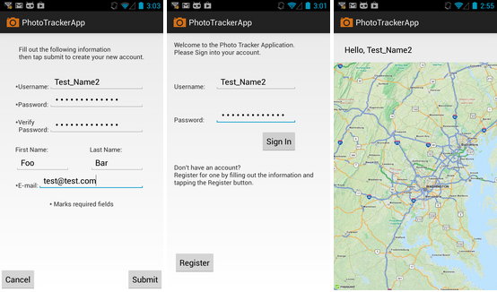
The Application
Screenshots of the implemented views

Slide 5
Backend Services
Photo Tracker App Server side is built with Spring Framework along with CXF framework.
On the Data Access Object (DAO) layer; Amazon Web Service: Simple Storage Service (S3) is used to store User information and photo information with the geo location data in the cloud.
Photo Tracker App Service provides Software-as-a-Service where multiple RESTful Web Services are exposed for the android app (devices) to consume.
Services Beans are managed by Spring Configuration; Spring framework takes care of the post construction and pre destruction necessities along with the life cycle of Service beans.
CXF Interceptors handle all HTTP Request with payload and use JACKSON JSON service providers to serialize and de-serialize payload objects.

Slide 6
Design and Quality
A Design document was created that outlined the Scope, Requirements and some diagrams for the application.
The Design document encompassed the whole application product, not just the design for the first iteration.
  With the limited time, only a sub-set of diagrams and use cases were written out. The team knows that there is potential for much more design documentation and this deliverable is a first version cut of the application design
All developed code was commented/documented and tested
There are some known issues that was documented in a side paper write up that specifically discusses the project and work done.

Slide 7
Findings
The Code Ninjas found that following a design document can be quite helpful.
  The document and mock-ups helped expedite development time because a lot of the pre-thinking on how to approach the implementation was already done.
  The design document also helps the developer stay on target with the scope and requirements laid out and avoid feature creep
The Design document can also assist making a quality product
  The design typically is made to be efficient to being with, this allows the software to be efficient initially. While it might not always be the end-all solution, it can lead to a higher quality product with better performance or optimization.

Slide 8
Conclusion
This project has taught the Code Ninjas
  That it is important to have a design laid out before developing code
  It is more efficient to know what is expected of the code ahead of time
  Focus on Quality and Design helps produce a better quality product, even in the initial iterations
There is still a lot that would need to be implemented before the app could be released.
  The needed functionality would be continuously added iteration by iteration until the final product is reached.
  For this product only one iteration was accomplished for the development phase
Overall this was a fun and challenging project

